Slide 1
POLI 202 The Government of Canada
Political Parties

Slide 2
Outline
The history of party systems in Canada
How parties work
Voting behaviour

Slide 3
Party Systems in Canada
Before we begin studying party systems, we need to define what they are.
« The pattern of competition and cooperation among all political parties within a given political system. »
This includes the configuration of the parties in the system: how many parties, and which are they.
It also includes the bases of support of these parties.

Slide 4
Party Systems in Canada
According to the textbook, there are 4 different stages in the evolution of party systems in Canada
Bipartisan party system (1867-1921)
Appearance of third parties (1921-1957)
The nationalization of political parties (1963-1988)
The regionalization of political parties (1993-2015)

Slide 5
Party Systems in Canada
The first party system spans the period going from the foundation of Canada to the first election following World War 1.
There were not many differences in the political positions defended by these parties.
Politics under the first party system were thus an affair of patronage.

Slide 6
Party Systems in Canada
What is patronage?
“The use of state resources to reward individuals for their electoral support.”
Politicians would be elected, and then would use their power to reward their supporters with jobs in their ridings, access to the railroad, etc.

Slide 7
Party Systems in Canada
Questions?

Slide 8
Party Systems in Canada
A key reason for the emergence of the second party system was linked to World War 1.
Wartime conscription proved a particularly divisive issue.
The contrast was particularly marked across languages, with English Canadians favouring conscription and French Canadians opposing it.

Slide 9
Party Systems in Canada
This division had an impact on the two parties of the time.
The Conservatives, who were in government, supported conscription.
The Liberals opposed the government.
The Conservatives won in 1917 on a pro-conscription platform, but lost to the Liberals in 1921.

Slide 10
Party Systems in Canada
The 1921 election was remarkable for other reasons.
It marked the entry of a new party in the political arena: the Progressive Party.
This marked the increasing importance of regional and class based divisions in Canadian politics.
This meant the end of strict bipartism in Canada.

Slide 11
Party Systems in Canada
This marks the beginning of the second party system.
The economic depression of the 1930s led to the emergence of two new political parties defending western populism.
The Co-operative Commonwealth Federation represented a left-wing alternative.
The Social Credit represented a right-wing alternative.

Slide 12
Party Systems in Canada
This period also marked the beginning of brokerage politics in Canada.
Brokerage politics refers to the idea of brokering an agreement between multiple sides on a given issue.

Slide 13
Party Systems in Canada
Politics in the second party system were not ideological, but they were not based in patronage either.
They revolved around the idea of problem-solving conflict between many groups.
French vs. English
Rural vs. Urban
West vs. East
Class Conflict

Slide 14
Party Systems in Canada
The Liberals maintained their advantage in Quebec during this time period.
In doing so, they managed to win most elections and become the « natural governing party » over this time period.

Slide 15
Party Systems in Canada
Questions?

Slide 16
Party Systems in Canada
The Liberal hold on government lasted from 1935 to 1957.
It was broken by John Diefenbaker.
He was then defeated in 1963.
This marks the beginning of the third party system.

Slide 17
Party Systems in Canada
The Liberals returned to their dominant position in the third party system.
Lester B Pearson and Pierre-Elliot Trudeau are the two defining Prime ministers of the time period.
The CCF rebranded itself as the New Democratic Party (NDP). It then took on the role of defending workers in addition to farmers.

Slide 18
Party Systems in Canada
Furthermore, many changes happened at the time to electoral competition.
Politics became more ideological, with the structure of left-right politics we are familiar with today.

Slide 19
Party Systems in Canada
Trudeau developed a national strategy, based on symbols of Canadian identity. (Charter of Rights and Freedoms, official bilingualism, multuculturalism)
During this time period, the parties started appealing to the whole country at once, rather than select groups.
This is the period of nationalized campaigning in Canada.

Slide 20
Party Systems in Canada
One reason for this nationalization of electoral campaigns rests upon the emergence of new technology.
Television.
It would lead to the first leader’s debate, which we still have today.
Also radio, airplanes facilitate national campaigning. Can send a message and visit all regions of the country more easily.

Slide 21
Party Systems in Canada
It is not because the parties tried to campaign nationally that they succeeded.
The Liberals still did poorly in the West.
Conservatives did well in English Canada.
Liberals had to get enough support in urban Ontario to win (coupled with their traditional base in Quebec)
Conservatives struggled in Quebec.

Slide 22
Party Systems in Canada
Questions?

Slide 23
Party Systems in Canada
After Trudeau’s departure from politics in 1984, Mulroney led the Conservatives to victory.
Key topics for Mulroney were constitutional negotiations and negotiating a Free Trade Agreement with the United States.
They won most of Quebec’s seats, a rare feat for the Conservatives.
This was a risky gamble, as the coalition rested on support from the West and Quebec, which disagreed on the topic of Quebec’s place in Canada.

Slide 24
Party Systems in Canada
The first mandate went rather well.
The government prepared the Meech Lake Accord, which received wide support from provincial premiers (including Quebec’s).
They also succesfully negotiated the free trade agreement with the U.S.
This paved the way for a second Conservative government in 1988, once again relying on support from Quebec and the West.
It seemed like the “risky gamble” had paid off.

Slide 25
Party Systems in Canada
However, this success would not last.
The free trade agreement led to sharp criticisms.
The economic situation of the country took a turn for the worse.
Most importantly, the constitutional negotiations (Meech and Charlottetown) were never concluded succesfully.
This led many to stop supporting the Conservative Party.
It also led to the creation of two parties that adopted regional perspectives rather than national ones.

Slide 26
Party Systems in Canada
As seen before, parties in Canada were trying to run campaigns while promoting national unity and brokerage politics.
Not so much for the two parties that appeared in the 1993 election.
The Bloc Québécois, a sovereignist party with candidates only in Québec, said it would represent the interests of Québec in the House of Commons.
The Reform party thought it could represents the interests of the West in the House of Commons.

Slide 27
Party Systems in Canada
The creation of these two parties left the Conservative party without a base.
In the 1993 election, it went from 156 seats to only 2!
The NDP was reduced to 8 seats.
The Bloc Québécois won 54 and the Reform won 53.
The Liberals won 177, in large part thanks to support in Ontario.

Slide 28
Party Systems in Canada
The Liberals ruled for over a decade after 1993.
The right-wing parties (Conservative and Reform/Alliance) realized that the division of right-wing votes between two parties was a problem.
They thus merged under the new Conservative Party of Canada, of which Stephen Harper became the first leader. (2003)
The Conservative Party won in 2006.

Slide 29
Party Systems in Canada
The Bloc Québécois remained relatively strong during this time period.
It lost steam after 1993, but regained a lot of support after the sponsorship scandal (2004 election).
However, it did not manage to maintain this level of support during the time Harper spent in government.
It came back with 32 seats in 2019.

Slide 30
Party Systems in Canada
Questions?

Slide 31
How parties work
Political parties are institutions that have many roles in Canada.
They play a role in parliamentary representation.
They are responsible for ensuring the link between the electorate and the governance of Canada.

Slide 32
How parties work
Party membership in Canada is fairly low. (1-2% of the public)
This is despite the fact that parties can include members who are not voters (noncitizens, people under 18).
Certain groups are overrepresented. (whites, men, older people, wealthier people)
Parties do try to change this fact, by creating commissions and clubs targeting underrepresented groups.

Slide 33
How parties work
There are many rules limiting how parties are financed in Canada.
They were introduced in the 1974 Elections Expenses Act.
This encouraged donations and encouraged parties to maintain contact with individuals in-between elections.
It also ensured greater transparency.

Slide 34
How parties work
In 2003, PM Jean Chrétien adopted a law making it illegal for corporations and unions to donate to political parties.
The maximum donation was set at 5000$ by PM Chrétien.
It was later reduced further by PM Harper, and now stands at about 1575$ per party.

Slide 35
How parties work
For provincial politics, rules vary per province.

Slide 36
How parties work
Party activities tend to be very busy around election time.
Things are less busy between elections.
Many members would like to have greater influence in the party, especially regarding the creation of party policy.

Slide 37
How parties work
The choice of local candidates is largely left to the choice of the members.
Party leaders have the ability to veto a candidate, but they rarely use it.
They may impose their candidate if they have a star candidate that they think would make a good minister, for instance.

Slide 38
How parties work
The selection of party leaders has become more open with time.
Initially, leaders were selected by a small group that included parliamentarians and party insiders. There was very little influence from the party members.
The 1960s saw the beginning of large delegate conventions.

Slide 39
How parties work
With time, even delegate conventions seemed too restrictive.
The first parties to change the model federally were the Reform Party and the Bloc Québécois.
The adopted models in which all party members could cast a vote for the leader.
The other parties had to follow because of pressure from their own members.

Slide 40
How parties work
The NDP follows a direct model of one-member, one-vote.
The Conservative Party has adopted a system where individual votes are weighed so that each constituency has the same weight.
Finally, the Liberals have adopted a system where even non-members can vote as « sympathizers ».

Slide 41
How parties work
Questions?

Slide 42
Voting Behaviour in Canada
In order to function, political parties need electoral support.
We are thus going to conclude with an overview of voters in Canadian politics.
How many Canadians vote?
Who votes for whom?

Slide 43
Voting Behaviour in Canada
Abstention in Canada is fairly high.
Abstention has varied from 25% to 40% since the end of the second World War.
A Royal Commission on the topic identifies three institutional reasons for this low turnout.

Slide 44
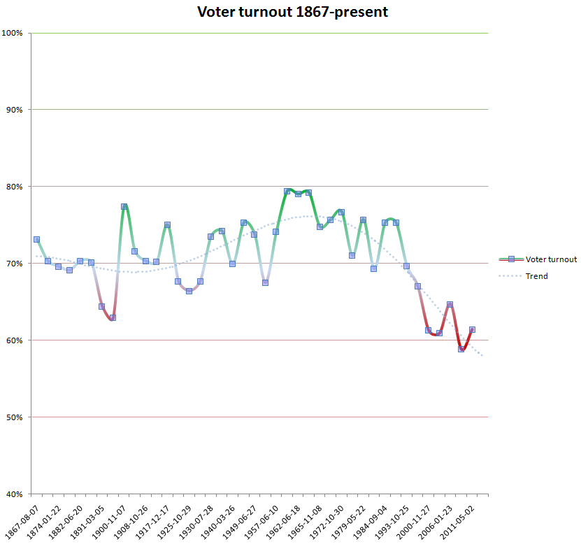
Voting Behaviour in Canada

Slide 45
Voting Behaviour in Canada
3 institutional reasons.
No mandatory voting law. Unsurprisingly, countries that force citizens to vote by law have a higher turnout.
Bicameralism: countries with two chambers also typically see lower turnout in elections.
3. Majoritarian electoral system: These systems typically have lower turnout than countries using proportional systems of voting.

Slide 46
Voting Behaviour in Canada
The cause of the drop in turnout over time is due to generational change.
Youth are less interested in politics, less informed, and less likely to see voting as a duty.
Young voters show lower rates of participation.
They vote less than young generations who lived in previous times as well, so this does not only reflect a difference in age.

Slide 47
Voting Behaviour in Canada
Many explanations have been offered to explain vote choice in Canada.
Some argue that the vote is based on sociodemographic characteristics.
These characteristics include region, religion, language, unionization and gender.

Slide 48
Voting Behaviour in Canada
Traditionally, the Liberals obtained many votes in Quebec, and the Conservatives obtained votes in the West.
So did the NDP, to a lesser degree.
This was interrupted by the 1993 election.

Slide 49
Voting Behaviour in Canada
Since 1993, the Liberals have done well in Ontario and the Atlantic Provinces.
The Reform replaced the Conservative Party in the West until the merger between the two.
The Bloc Québécois has done well in Quebec.

Slide 50
Voting Behaviour in Canada
Religion is strongly associated with vote choice in Canada.
Catholics are more likely to vote Liberal.
Protestants are more likely to vote Conservative.
Non-believers are more likely to vote for the NDP.
These results are robust over time, despite the fact that there exist little religious character in Canadian politics.

Slide 51
Voting Behaviour in Canada
Language and origins also matter for the vote.
French Quebecers are much more likely to vote for the Bloc Québécois than other Quebecers.
English-speaking citizens are more likely to support the Conservatives.
Linguistic minorities are much more likely to vote for the Liberal Party.
Citizens who are not of European descent are more likely to vote for the Liberal Party.

Slide 52
Voting Behaviour in Canada
Another variable that explains voting behaviour is party identification.
Party identification is a psychological attachment to a given political party.
The voter thinks of themself as being a Liberal, Conservative, etc.
It is the strongest single determinant of the vote.

Slide 53
Voting Behaviour in Canada
In Canada, about half the public identifies with a political party.
Half of this group identifies with the Liberal party.
This gives the Liberal party a strong advantage, as it has a bigger base than the other parties.

Slide 54
Voting Behaviour in Canada
Other factors that matter are issues and leader evaluations.
Canadians will vote for the party that most closely defends their position on issues.
This can also be understood on the basis of ideology (Left vs. Right) rather than specific issues.

Slide 55
Voting Behaviour in Canada
Finally, leader evaluations will matter as well.
Traits matter:
Competence
Leadership
Intelligence
Honesty
Empathy

Slide 56
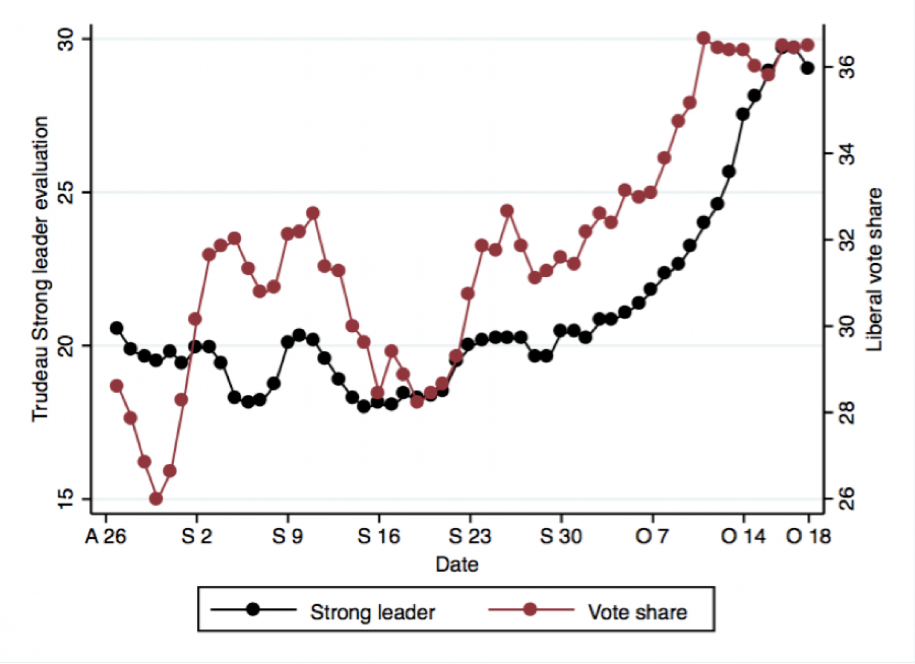
Voting Behaviour in Canada
This is a comparison of perception of Trudeau as a strong leader and voting intentions for the Liberals in the 2015 election.
We can see clearly that the two are closely linked.

Slide 57
Voting Behaviour in Canada
Voting behaviour can thus be said to be a function of:
Sociodemographics
Party identification
Issue positions
Leader evaluations

